Slide 1

Classifying posts in r/running and r/swimming
Dylan lee

Slide 2
Problem Statement
Being able to identify the fitness interests of internet users can enable the construction of recommendation engines that send the users targeted ads or links.
How might we identify what kind of physical activities are being discussed?
This is a proof of concept exercise that uses natural language processing to identify posts that are made on two reddit subreddits, r/running and r/Swimming.
We are looking to construct a model can suitably identify contextual words used alongside a discussion on either activity, without looking for word stems of either activity, such as run, ran, running, runner, swim, swam, swimming, swimmer
If a suitable model and methodology is found, this can be extended to other activities such as biking or weightlifting to develop a more comprehensive recommendation system.

Slide 3
About the Subreddits
r/running
~ 1 million subscribed users
Primarily text based posts from users discussing their personal fitness regiments or seeking advice
Available post flairs included: Articles, PSA, Safety, Nutrition, Questions, Training, Race reports
r/Swimming
75k subscribed users
Primarily text based posts from users discussing issues around swimming, seeking general advice or discussing competing in school
Available post flairs included: Beginner Questions, Pool Ettiquette, Triathalon, Open Water, Dry Land, Racing, Technique
Given that both subreddits were primarily concerned with users discussing the activity on a personal level rather than discussing professional athletes, they are valid for our investigation

Slide 4
Methodology
1000 posts from the two subreddits were webscraped
The posts were filtered for duplicates and media posts
A random sample of 750 text posts were taken from each subreddit
The self text content of there posts were filtered for stop words as well as words clearly identifying the activity, before being stemmed
The posts were split into training and testing sets
Various models were tested to see which were the most successful at classifying test posts into their respective subreddits

Slide 5
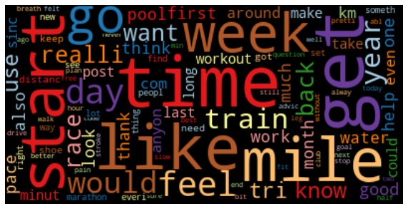

Slide 6
Model Accuracy
CVEC LogReg Train Score: 0.88
CVEC LogReg Test Score: 0.86
-----
TFID LogReg Train Score: 0.91
TFID LogReg Test Score: 0.9
-----
HASH LogReg Train Score: 0.88
HASH LogReg Test Score: 0.86
-----
TFID KNN Train Score: 0.87
TFID KNN Test Score: 0.844
TFID NB Train Score: 0.90
TFID NB Test Score: 0.90
-----
TFID CART Train Score: 0.83
TFID CART Test Score: 0.82
-----
TFID BAG Train Score: 0.86
TFID BAG Test Score: 0.83
-----
TFID ADABoost Train Score: 0.86
TFID ADABoost Test Score: 0.81

Slide 7
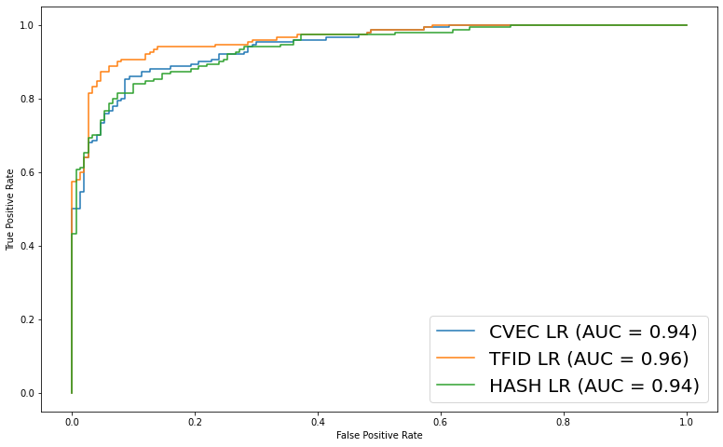
Modelling using logit
Results were good, with sklearn.TfidfVectorizer performing the best

Slide 8
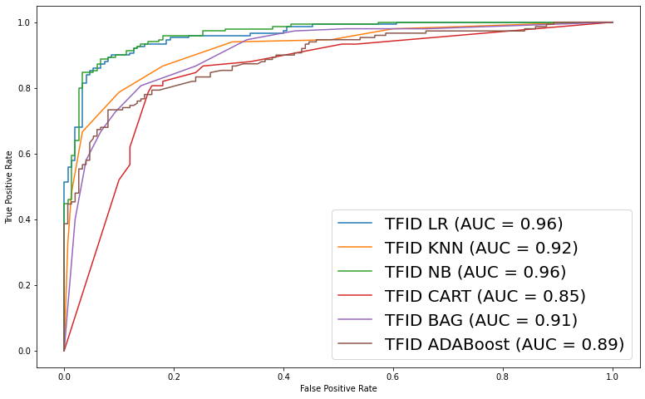
Modelling using alternatives to logit
KNN = K Nearest Neighbour
NB = Multinomial NB
Cart = Decision Tree Classifier
Bag = Bagging Classifier
ADABoost = ADABoost Classifier
Logit remained the best model

Slide 9
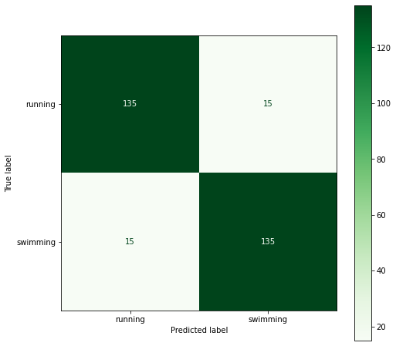
Accuracy of predictions
15 posts were misclassified in either direction
Accuracy for both subreddits: 90%
When words directly related to both subreddits were included (running and swimming lemmas), accuracy increased to almost 100%

Slide 10
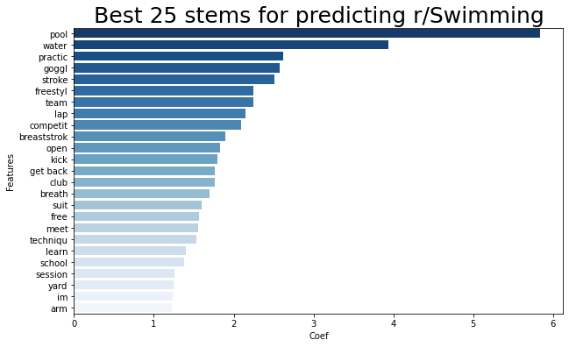
r/Swimming Identifiers
Many words one might reasonably expect to see in discussions of swimming appear here
Words that might apply to both swimming and running such as “lap” might still be more strongly associated with one sport

Slide 11
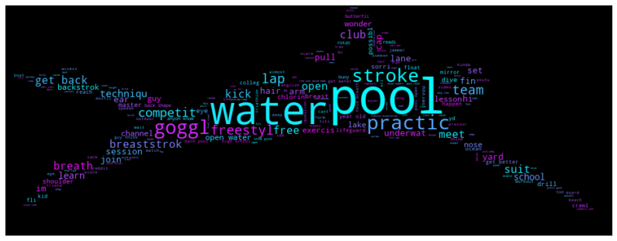
r/Swimming wordcloud

Slide 12
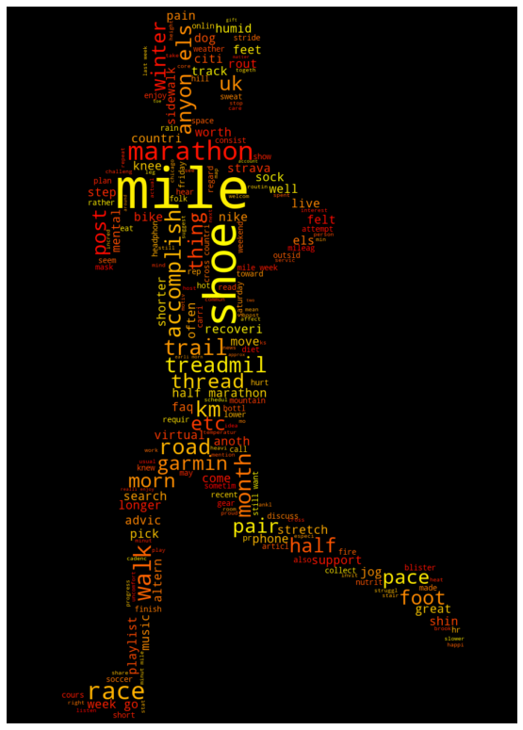
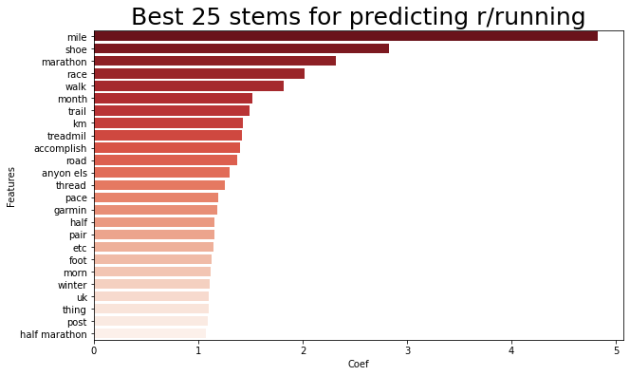
r/running identifiers

Slide 13
Misclassified Swimming Posts
Post title: First swim in 6 months due to COVID
Ah man that was GOOD. Had a double width lane to myself the entire time. Swam for 45 mins and did a little over 2km. Impressed myself!
And I don't feel like I've been hit by a car. I think I'll have to put in more effort next time :-)
Post title: Dry Training for Open Water
Hello, I swim 1.5km (almost a mile) once or twice a week in summer, and I've struggled to put together a dry land training regime to help me improve my time/fitness (let's ignore my form for the moment).
I've got access to a gym now with a full weights set and cardio machines (treadmill, bike, rowing machines). Can anyone give me some pointers on what to start on for a dry land program (or even some bodyweight program work) to help my swimming fitness / strength? If you are comfortable sharing your program it would be greatly appreciated.

Slide 14
Misclassified Running Posts
Post title: I tried out for the U19 Cross Country team - need some tips and advice
Hi everyone, I am a high school student who recently just tried out for the cross country team. I was the only U19, which means I made the team automatically, but I did terrible at the tryouts (ran less laps than the U14s) and I want your tips and advices on how to get better as a runner, as well as the amount of time that I need to commit each week.
I am worried that I won't have enough time to train (the tournament is on December) and am even thinking about whether I should just drop the team or not...
Post title: When do you take your supplements when you run in the morning?
If you go for a run in the morning and if you take supplements, do you usually take them before your run or after? I get up at 7am for a 7:30am run. I tried taking them before my run, but there is no way I can drink 16oz of water with it right before I run.

Slide 15
Limitations
The posts available to the model are reflective of the demographics of their respective userbases
Swimming is more niche and there are many more posts about technique and competing
It also appears to have many more young athletes as a percentage of the user base
Running has more hobby runners and the discussion topics are broader and less focused
The model is currently only being tested on the source communities
Testing on different communities and different demographics might cause the model accuracy to drop significantly
Demographic concerns include both reddit as a whole and the respective subreddit user bases
Active posters on reddit tend to be much more likely to be below 30
Given that Logistic Regression can only make predictions between two classes, accuracy and the necessity of using a model capable of multiple category classification will decrease in broader applications

Slide 16
Further Considerations
Including the words run, swim and their associated grammatical forms significantly increases the accuracy of the model and prevents a lot of the misclassified post
In a deployment situation with the core activity words allowed, the model would be able to much better predict the subject matter of the discussion
The application will be even more applicable with additional training, additional subjects as well as some method for interaction terms
For example: kick + lap probably indicates swimming technique, kick + gait probably indicates a discussion about running technique, kick + pads probably indicates a kickboxing discussion,

Slide 17
Conclusion
The results from this project show promise for classifying the word content of user posts into a useful prediction system
Larger datasets to train on, controls for communities or training on local data from the target communities would improve accuracy.
Thank you for listening!

